Slide 1
TSLA Stock Prediction
Using Multilinear and Logistic Regressions
https://github.com/michaelbutler2020/final_ml_project

Slide 2
Exploratory Data Analysis
In order to fully understand and get a better idea of the data set, I used the following EDA techniques.
Looking at a snapshot of data, number of columns and rows.
Look at data types and to see if there are any null items.

Slide 3
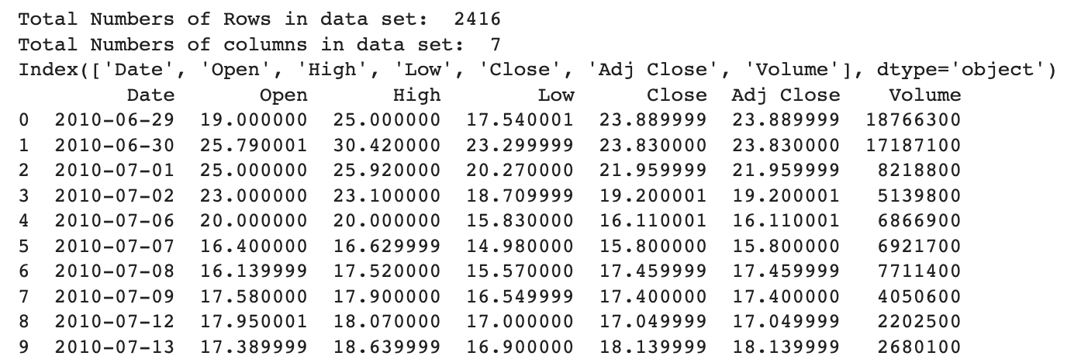
A snapshot of the data

Slide 4
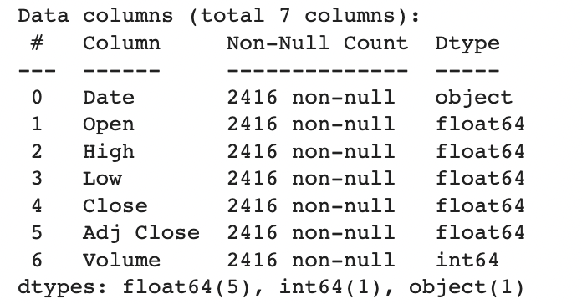
The columns and their data types are below. There are 5 float64, 1 int64, and 1 object.

Slide 5
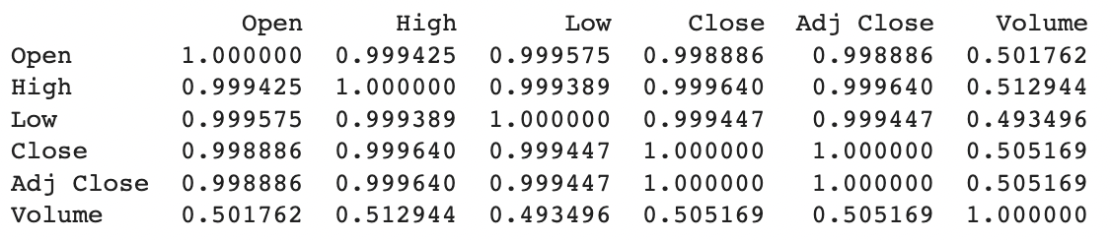
This is the correlation matrix of the data

Slide 6
0.9997
The score of the Linear Regression model

Slide 7

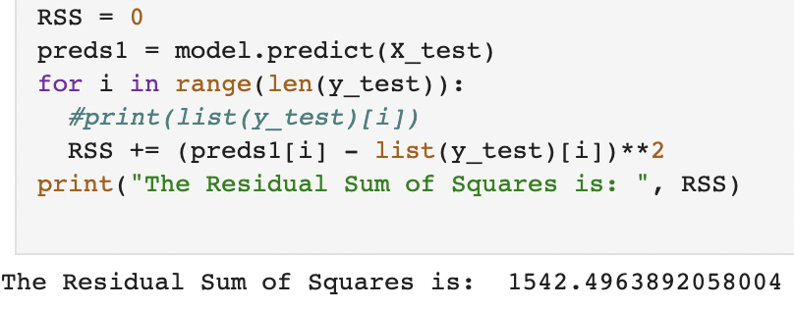
Prediction using Linear regression and calculating RSS.

Slide 8
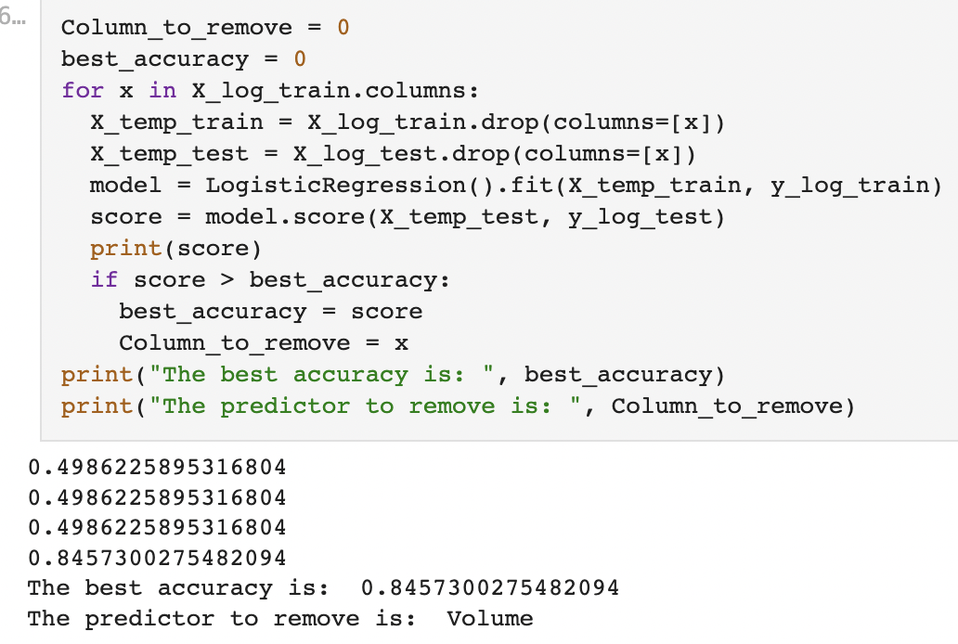

Slide 9
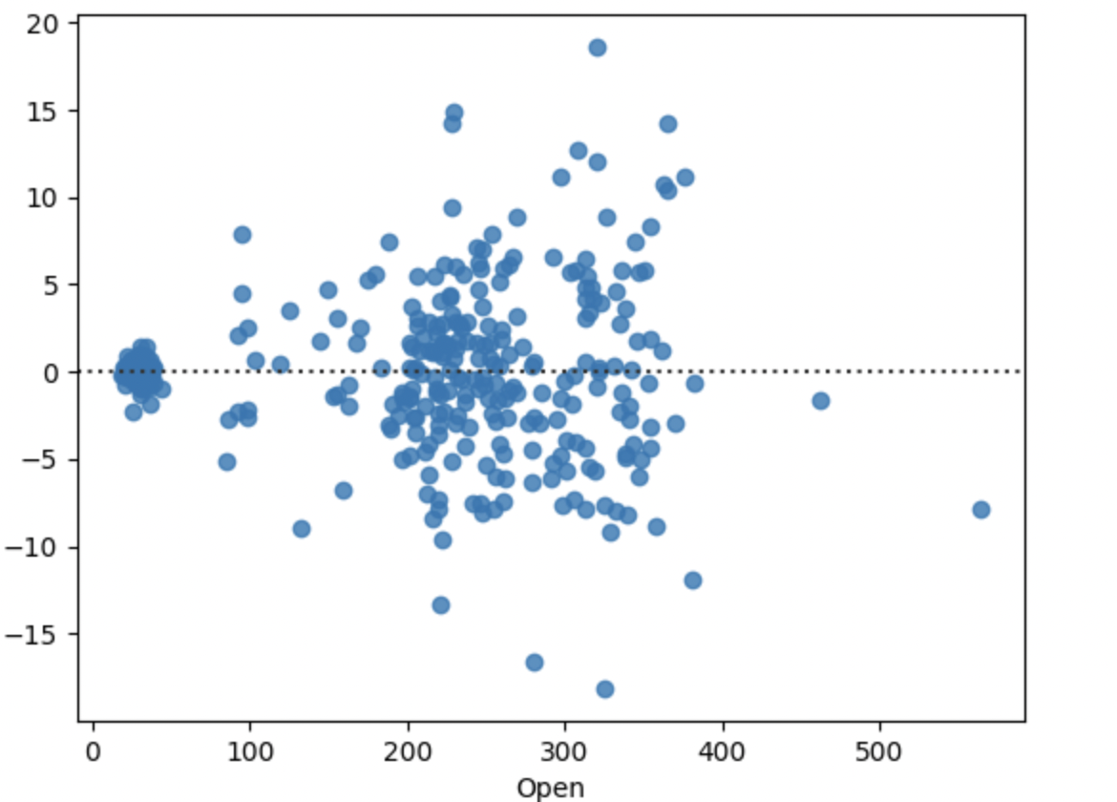
Residual Plot of Linear Regression compared to Open price.

Slide 10
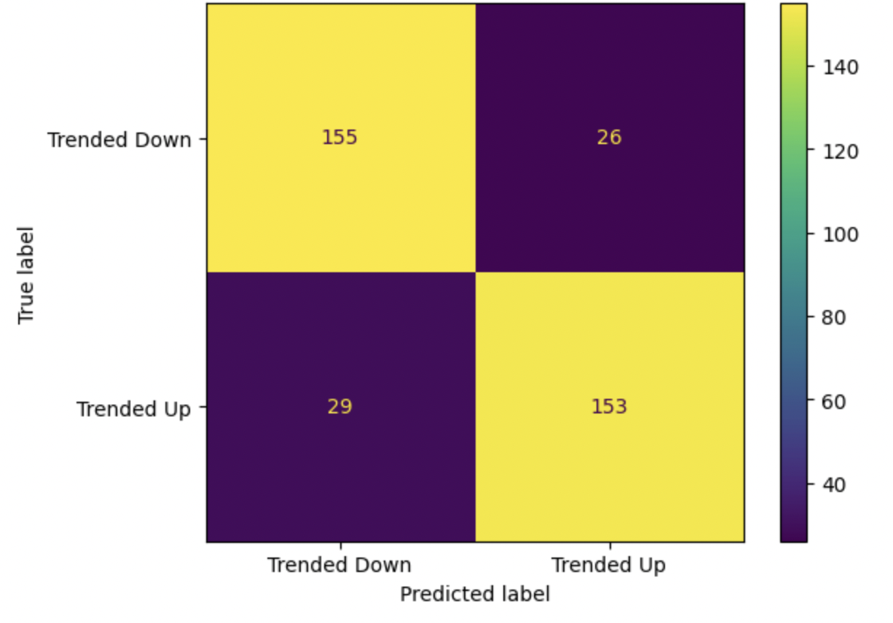
Confusion matrix for Logistic Regression prediction

